Slide 1

Academic Session 2025-26
ODD Semester Jul-Dec 2025
UNIVERSITY INSTITUTE OF ENGINEERING
COMPUTER SCIENCE ENGINEERING
Bachelor of Engineering
Semester: 6th
Design and Analysis of Algorithms
(23CSH-301/ITH-301)
Unit No. 1 Chapter No. 3 Lecture No.14
Topic : Sorting algorithm In Linear Time (Bucket Sort)
Richa Dhiman E11307 Assistant Professor

Slide 2
1
Learning Objectives & Outcomes
Objective:
To understand Sorting algorithm In Linear Time
Outcome:
Student will understand Sorting algorithm In Linear Time.

Slide 3
2
Bucket Sort
Bucket sort assumes that the input is generated by a random process and drawn from a uniform distribution. In other words the elements are distributed uniformly and independently over the interval [0,1].
Bucket sort divides the interval [0,1] into n equal sized subintervals or buckets. Then distributes the n inputs into these buckets.

Slide 4
3
Bucket Sort Algorithm
Bucket-Sort(A)
1.Let B[0….n-1] be a new array
2.n = length[A]
3.for i = 0 to n-1
4. make B[i] an empty list
5.for i = 1 to n
6. do insert A[i] into list B[└ n A[i] ┘]
7.for i = 0 to n-1
8. do sort list B[i] with Insertion-Sort
9.Concatenate lists B[0], B[1],…,B[n-1] together in order

Slide 5
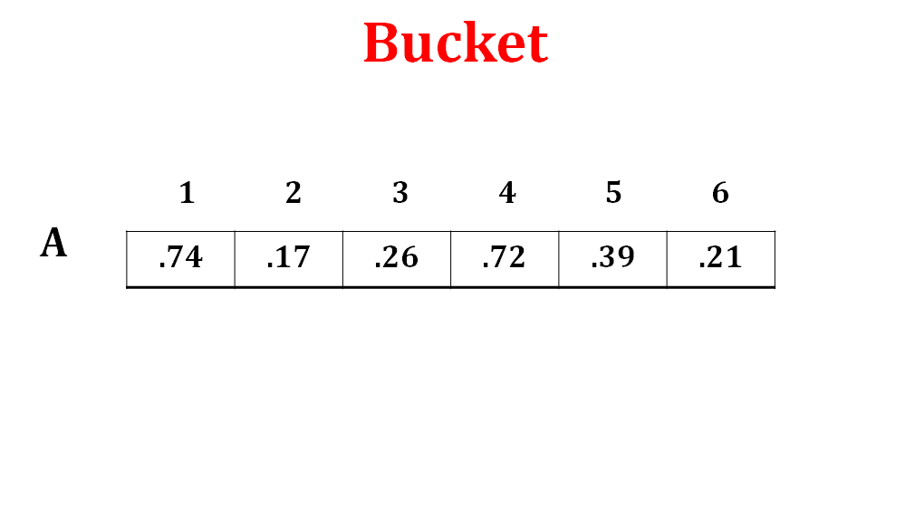
4
EXAMPLE

Slide 6
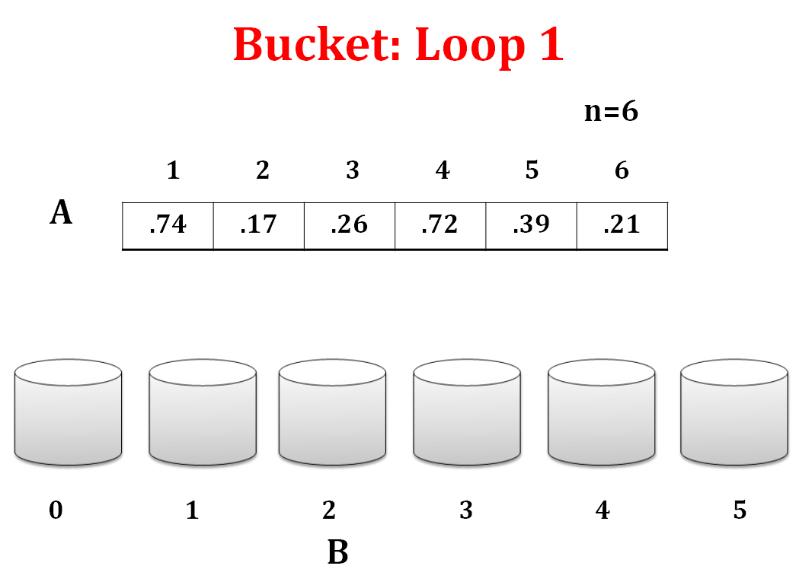
5

Slide 7
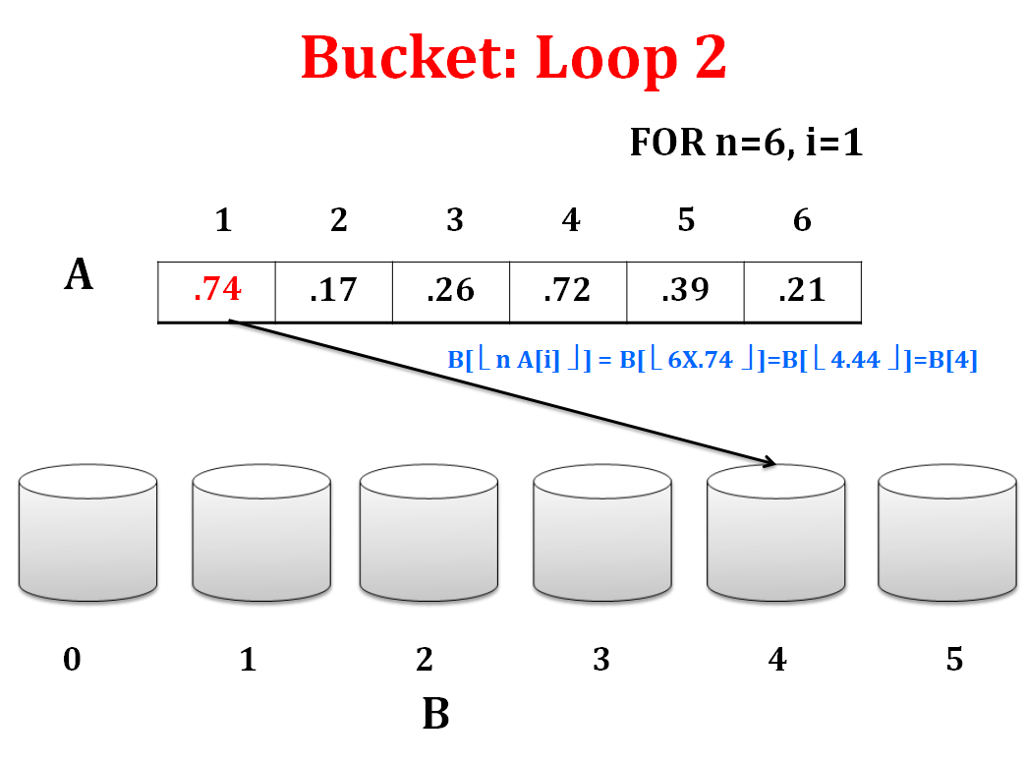
6

Slide 8
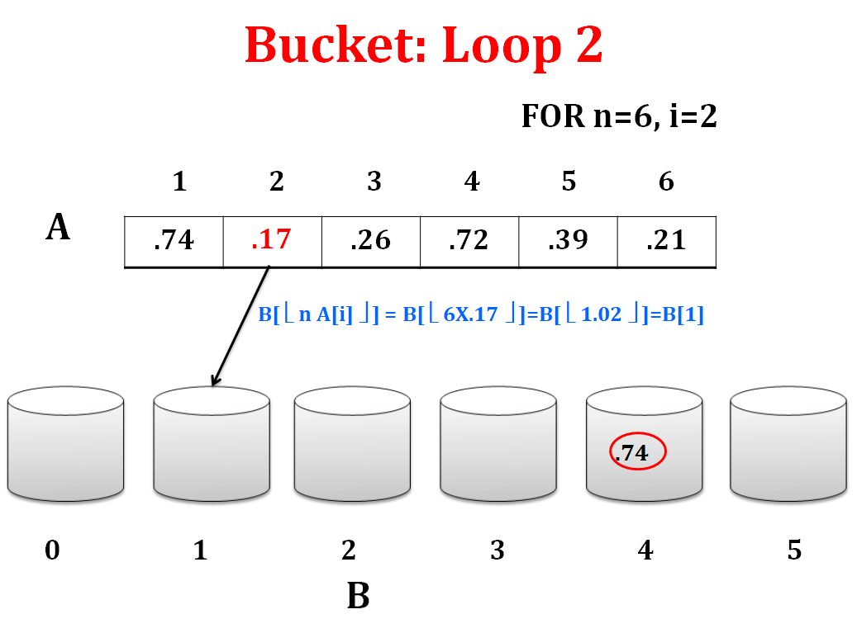
7

Slide 9
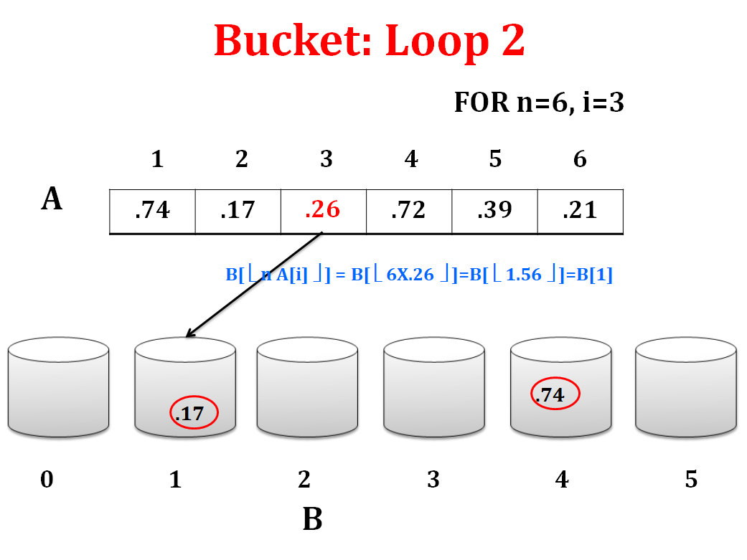
8

Slide 10
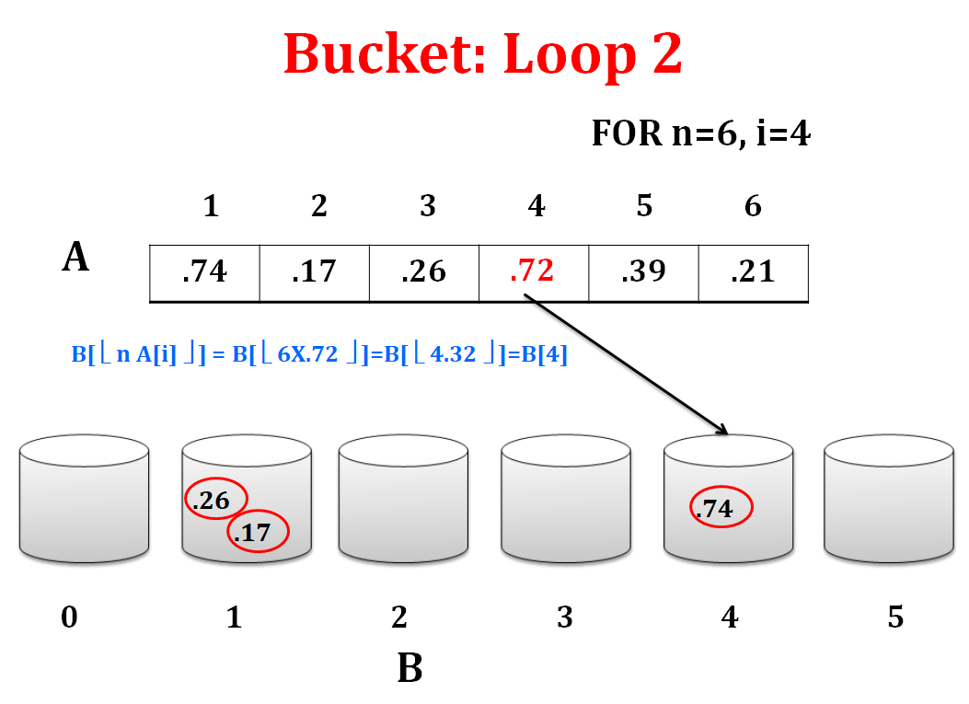
9

Slide 11
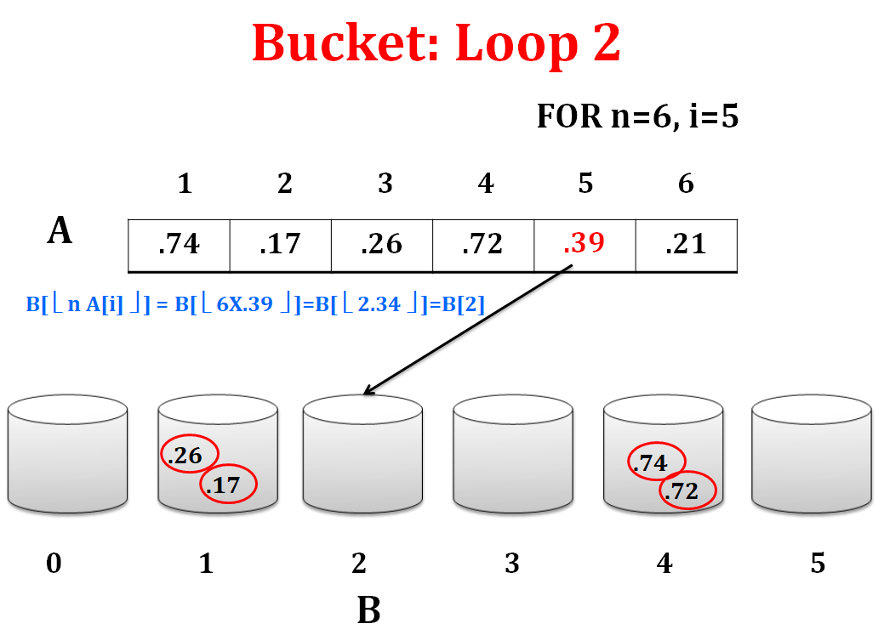
10

Slide 12
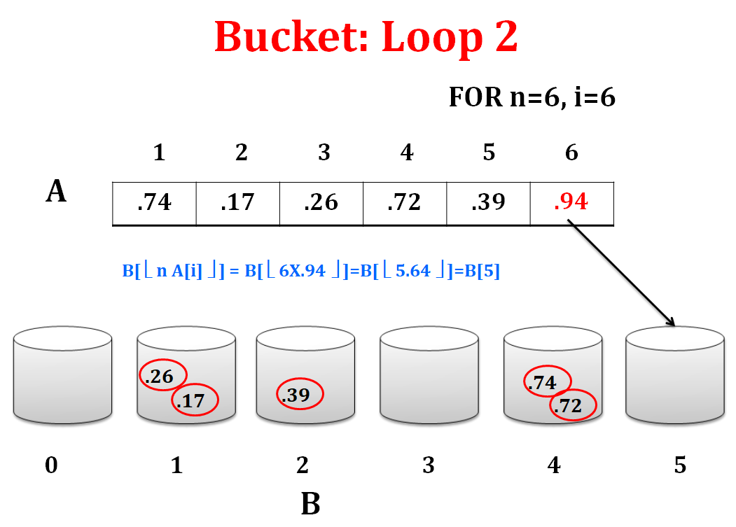
11

Slide 13
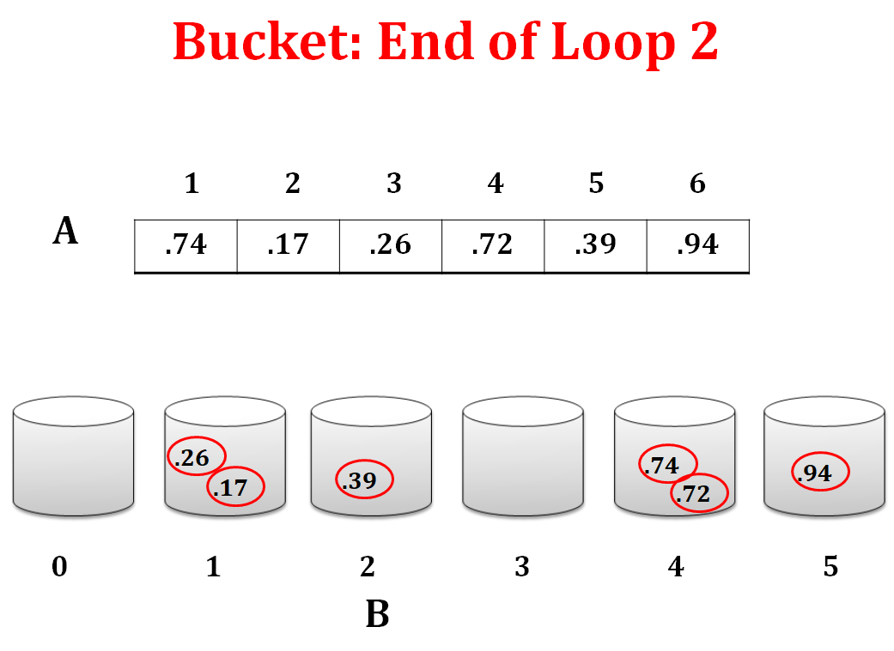
12

Slide 14
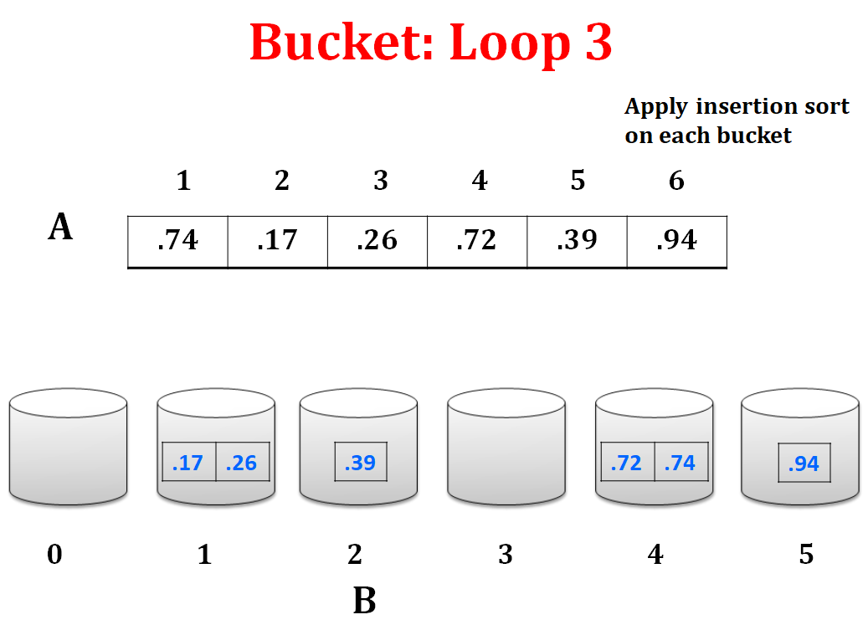
13

Slide 15
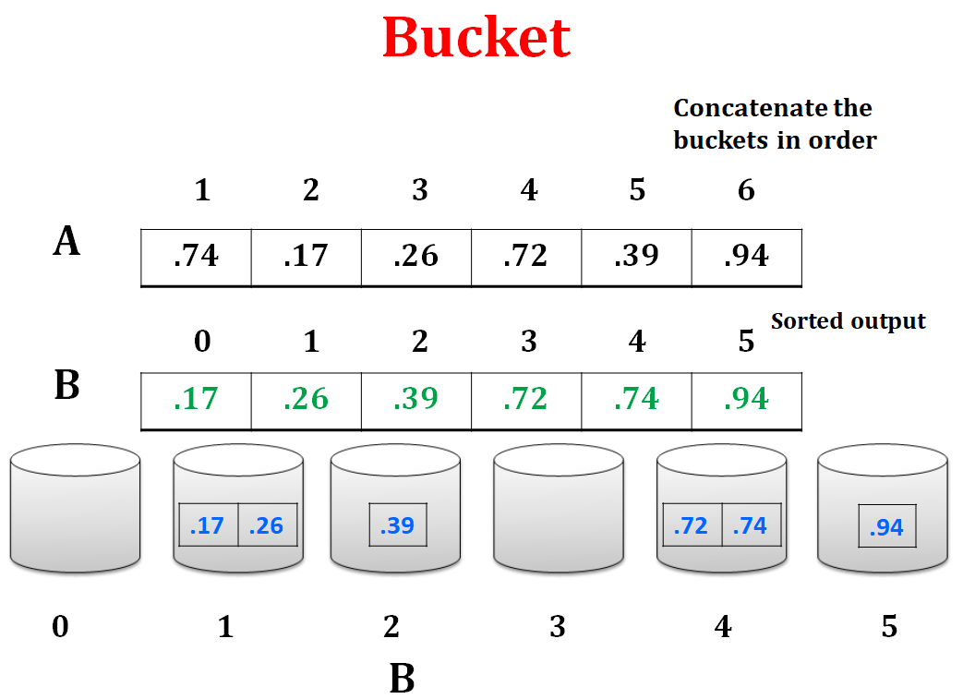
14

Slide 16
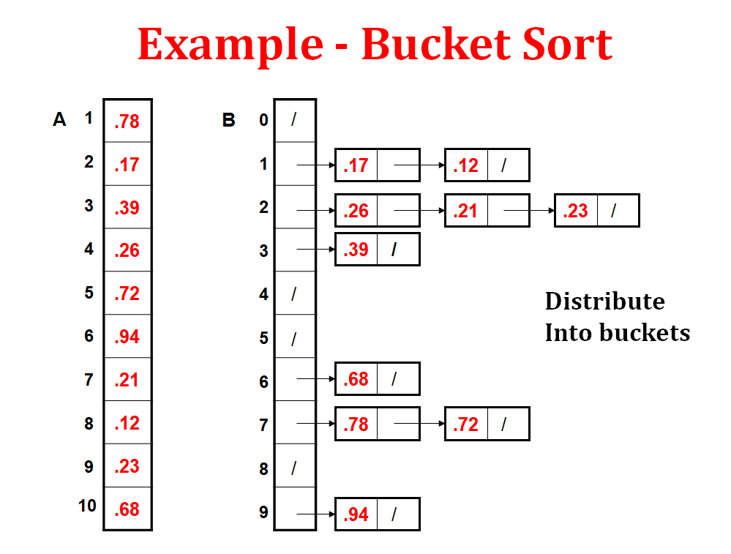
15

Slide 17
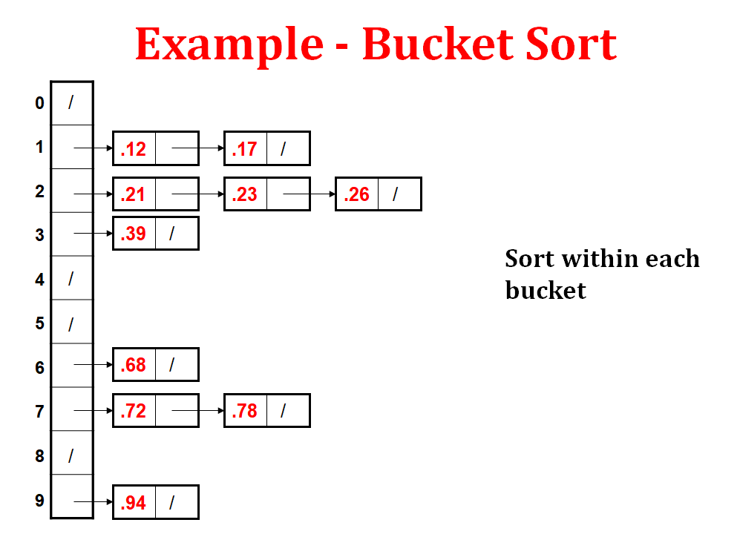
16

Slide 18
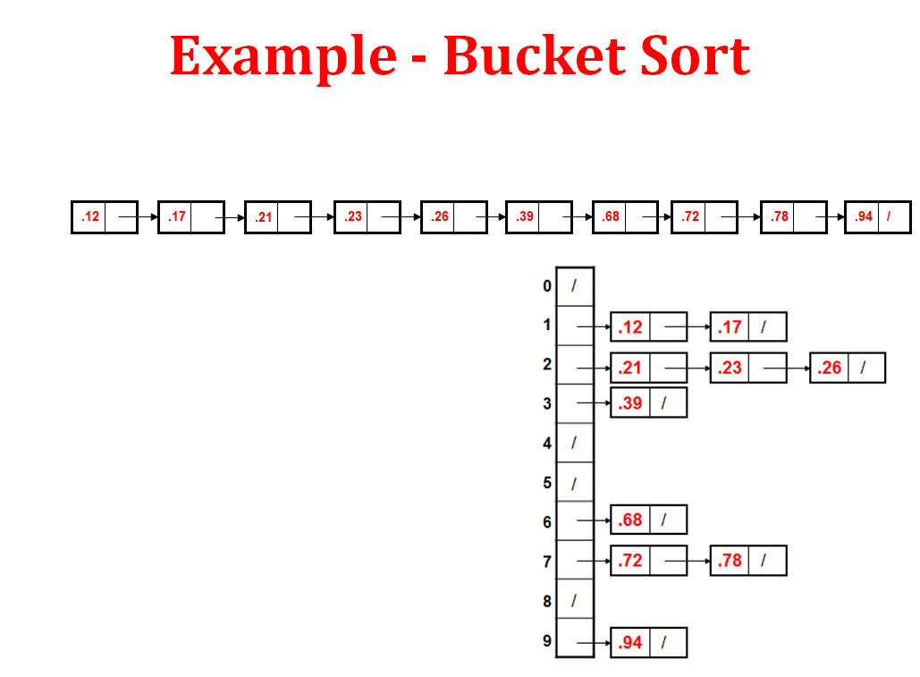
17

Slide 19
18
Basic idea
Partition the range into a fixed number of buckets.
Toss each element into its appropriate bucket.
Sort each bucket.

Slide 20
19
Pro’s of Bucket Sort
Fast
Asymptotically fast (i.e., O(n) when distribution is uniform)
Simple to code
Good for a rough sort.

Slide 21
20
Con’s of Bucket Sort
Doesn’t sort in place

Slide 22
21
Applications
Sorting uniformly distributed real numbers (e.g., between 0 and 1)
External sorting when data is too large to fit in memory and needs to be processed in chunks.
Floating-point number sorting with values in a known range.
Sorting grades or scores that are real numbers (e.g., GPA, percentage).
Sorting large datasets with a uniform distribution, like sensor readings.
Used in histogram-based image processing, such as equalization or segmentation.
Preprocessing step in radix-like hybrid algorithms, especially when dealing with decimals.
Parallel and distributed sorting, where buckets can be processed independently.

Slide 23
Summary
22
Sorting Algorithm in Linear Time
Radix Sort
Counting Sort
Bucket Sort

Slide 24
23
Quiz
Bucket Sort works best when the input data is: A) Sorted in descending order B) Uniformly distributed over a range C) Large integers with a huge range D) Random characters
In Bucket Sort, after distributing elements into buckets, each bucket is usually sorted using: A) Counting Sort B) Quick Sort or Insertion Sort C) Merge Sort D) Heap Sort

Slide 25
24
References/ Articles/ Videos
Text books:
Cormen, Leiserson, Rivest, Stein, “Introduction to Algorithms”, Prentice Hall of India, 3rd edition 2012. problem, Graph coloring.
Horowitz, Sahni and Rajasekaran, “Fundamentals of ComputerAlgorithms”, University Press (India), 2nd edition
Websites:
https://www.slideshare.net/shimulsakhawat/bucket-sort
https://www.geeksforgeeks.org › bucket-sort-2

Slide 26
25
Faculty-curated videos, NPTEL, Coursera, LinkedIn, or other relevant learning resources
https://onlinecourses.nptel.ac.in/noc23_cs96/preview
https://nptel.ac.in/courses/106106131
https://nptel.ac.in/courses/106106208
https://www.linkedin.com/learning/learning-algorithms

Slide 27
26
Class-Wise Feedback

Slide 28
27
Thank You
For queries
Email: richa.e11307@cumail.in

